Slide 1
What Is A Persona?
A persona is a way to model, summarize and communicate research about people who have been observed or researched in some way.
A persona is depicted as a specific person but is not a real individual; rather, it is synthesized from observations of many people.
Each persona represents a significant portion of people in the real world and enables the designer to focus on a manageable and memorable cast of characters, instead of focusing on thousands of individuals.
Personas aid designers to create different designs for different kinds of people and to design for a specific somebody, rather than a generic everybody.

Slide 2
What Does A Persona Look Like?
While a persona is usually presented as a one-pager document, it is more than just a deliverable — it is a way to communicate and summarize research trends and patterns to others.
This fundamental understanding of users is what’s important, not the document itself.

Slide 3
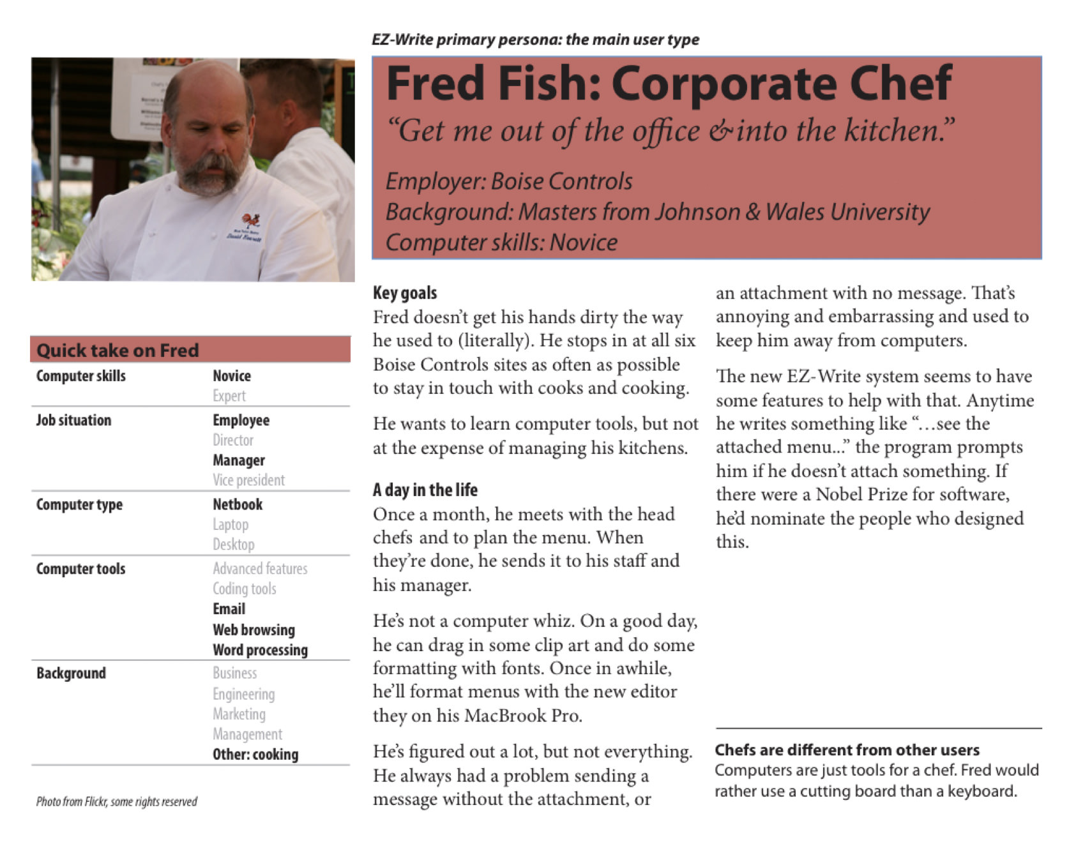
What Does A Persona Look Like? (Contd.)

Slide 4
What Does A Persona Look Like? (Contd.)
The main elements presented here are the key goals and the “Day in the Life,” which are common to all well-made persona documents.
Other elements, such as the “Quick Take on Fred” are included because of team and/or project requirements.
Each project will dictate a certain approach to producing persona documents.

Slide 5
What Does A Persona Look Like? (Contd.)
Personas are an essential part of goal-directed design. Each group of users researched is represented by a persona, which in turn is represented by a document. Several personas are not uncommon in a typical project

Slide 6
How Do Personas Fit In The Design Process?
Since its humble origin, Alan Cooper’s design methodology has evolved into a subset of user-centered design, which he has branded goal-directed design.
Personas are a core component of goal-directed design.
Personas are never used in isolation, but rather are implemented in conjunction with other processes, concepts and methods that support and augment their use.

Slide 7
COMPONENTS OF GOAL-DIRECTED DESIGN THAT SUPPORT PERSONAS
End goal(s)
This is an objective that a persona wants or needs to fulfill by using software.
The software would aid the persona to accomplish their end goal(s) by enabling them to accomplish their tasks via certain features.
Scenario(s)
This is a narrative that describes how a persona would interact with software in a particular context to achieve their end goal(s).
Scenarios are written from the persona’s perspective, at a high level, and clear use cases that will likely happen in the future.

Slide 8
COMPONENTS OF GOAL-DIRECTED DESIGN THAT SUPPORT PERSONAS (Contd.)
Personas, end goals and scenarios relate to one another in the same way that the main character in a novel or movie goes on a journey to accomplish an objective.

Slide 9
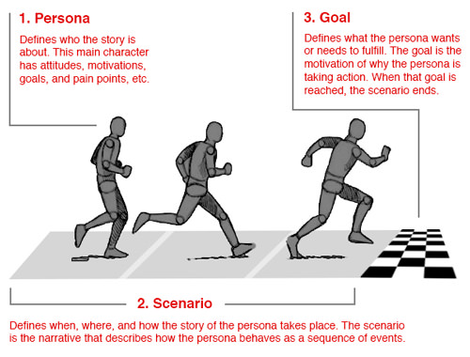
COMPONENTS OF GOAL-DIRECTED DESIGN THAT SUPPORT PERSONAS (Contd.)
The three parts of goal-directed design are most effective when used together. For instance, in order for a sprinter to reach their potential, they need a place to run and a finish line to cross. Without a scenario or end goal, the sprinter would have nothing to do or strive for.

Slide 10
How Are Personas Created?
Personas can be created in a myriad of ways, but designers are recommended to follow this general formula:
Interview and/or observe an adequate number of people.
Find patterns in the interviewees’ responses and actions, and use those to group similar people together.
Create typical models of those groups, based on the patterns found.
Drawing from that understanding of users and the model of that understanding, create user-centered designs.
Share those models with other team members and stakeholders.

Slide 11
How Are Personas Created? (Contd.)
Step 1: Pick a representative unit of users.
Depending on how many users you have to represent using your personas, decide how many interviews you need to conduct or how many survey responses you need to get to be conﬁdent in your conclusions.

Slide 12
How Are Personas Created? (Contd.)
Step 2: Be creative to get as many data points as you possibly can…or as necessary.
There are many ways to do this. “This” being, getting open-ended responses to your questions.
Utilize surveys, virtual/in-person discussion groups, even reverse Q&A sessions. Be creative and do what makes sense for your users.

Slide 13
How Are Personas Created? (Contd.)
Step 3: Read your responses and put together a ﬁrst pass at your personas.
Find a quiet spot and start reading through your responses. Jot down common words and phrases as you go to be used later for grouping.
Once you’ve completed this activity, go back and begin grouping respondents based on the commonalities between them.

Slide 14
How Are Personas Created? (Contd.)
Step 4: Fill in your template. Using your groupings from Step 3, ﬁll in your categories by formulating the group responses into one single, uniﬁed response.
You should be able to conﬁdently convey what their main challenges, needs, goals, and such are based on the group’s responses.
You probably have multiple groupings which means you’ll have multiple personas.
Try to keep your count between 3 and 6 in total. This will be version 1 of your personas!

Slide 15
How Are Personas Created? (Contd.)
Step 5: Conduct a few 1-on-1 user interviews.
Now that you have your version 1, you’ll want to make sure that your conclusions are valid and hold true for a random (but relevant) user.
Pick one user that matches one persona who hasn’t already been surveyed. Interview them individually.
Not everything has to be spot on but their answers should be relatively similar to your conclusions.
If not, reevaluate your original conclusions and try again. Do this for each persona.

Slide 16
How Are Personas Created? (Contd.)
Step 6: Place each user into a persona. Your users (or customers), minus the unimportant ones, should all fall under one of your personas.
Now is the time to separate your users based on your persona criteria.
There probably won’t be matches for all of them but there should be clear diﬀerentiators and indicators that guide your sorting.

Slide 17
How Are Personas Created? (Contd.)
Step 7 Bonus: Take note of unimportant users.
Not all users will fall under a persona. That’s ok.
But if you start to see a lot of them as you sort, reevaluate your personas.
Otherwise, these are just naturally unimportant people.

Slide 18
How Are Personas Created? (Contd.)
Step 8 Double Bonus: Give your personas a name.
Many personas have names attached to them, such as Marketer Mary.
You don’t have to assign names to yours but it makes it easier to communicate about them internally instead of saying, “Persona 3”.

Slide 19
References
https://www.smashingmagazine.com/2014/08/a-closer-look-at-personas-part-1/
https://www.smashingmagazine.com/2014/08/a-closer-look-at-personas-part-2/
https://www.slideshare.net/HubSpot/6-steps-to-building-user-personas-and-why-you-should-care

